Slide 1
Executive Insights for Atliq Hardware using SQL & Tableau
A Business Intelligence Case Study on Ad-Hoc Request Analysis

Slide 2

About Atliq Hardwares
Leading computer hardware company in India
Management needs data-informed decision-making
support.
Expanding operations across APAC, EMEA, and
North America
Focus on innovation and customer experience

Slide 3

Business Challenge
Management lacks timely insights for
data-driven decisions.
Solution:
Hire analysts who can:
Handle complex SQL tasks
Communicate data insights clearly
Create executive-level dashboards

Slide 4
Insights from Ad-Hoc Requests

Slide 5
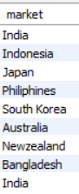
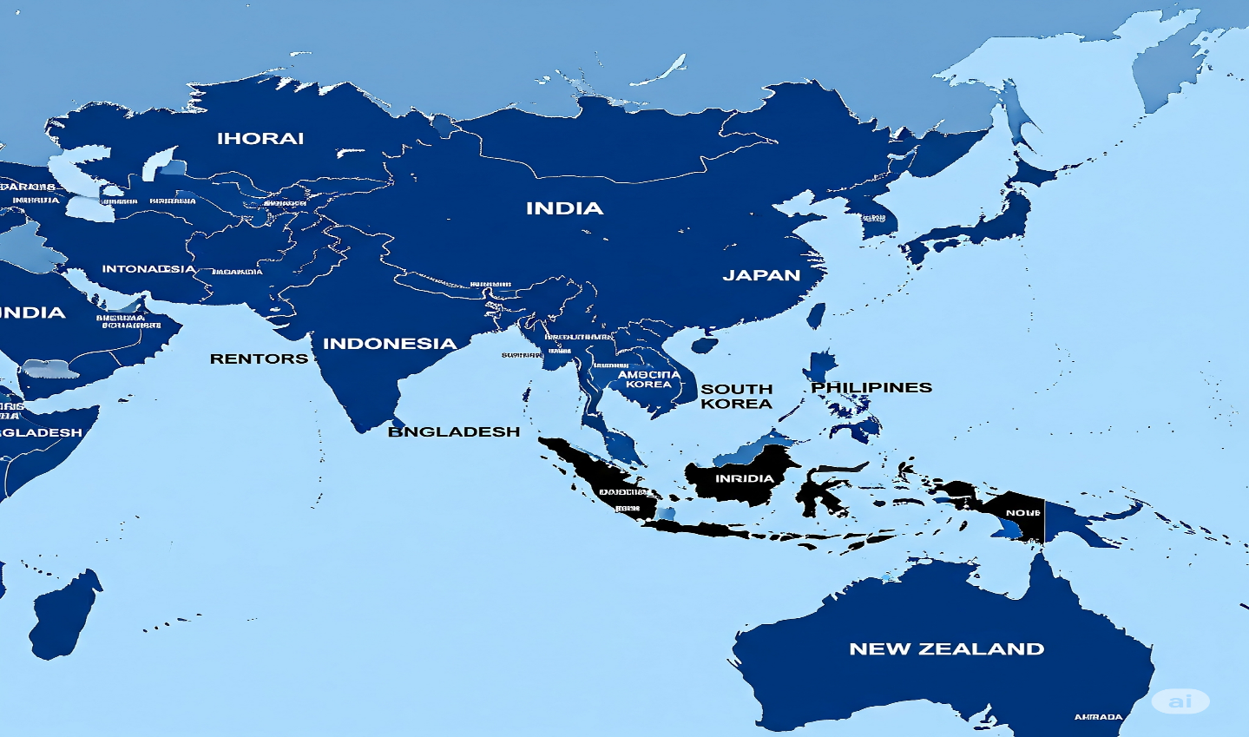
1. Provide the list of markets in which customer "Atliq Exclusive" operates its business in the APAC region.
Atliq Hardwares has a well-established presence in key Asia-Pacific markets, including India, Japan, Indonesia, and more. India stands out as a core market, consistently driving performance.

Slide 6
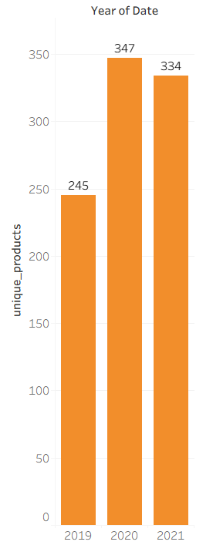
2.What is the percentage of unique product increase in 2021 vs. 2020? The final output contains these fields, unique_products_2020 unique_products_2021 percentage_chg
The company's overall business performance and activity grew significantly from 2020 to 2021, indicating healthy progress and market expansion.

Slide 7
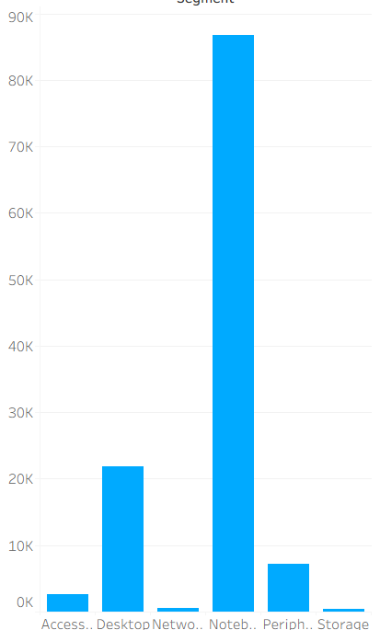
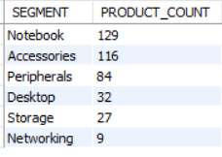
3. Provide a report with all the unique product counts for each segment and sort them in descending order of product counts. The final output contains 2 fields, segment product_count
The company's overall business performance and activity grew significantly from 2020 to 2021, indicating healthy progress and market expansion.

Slide 8
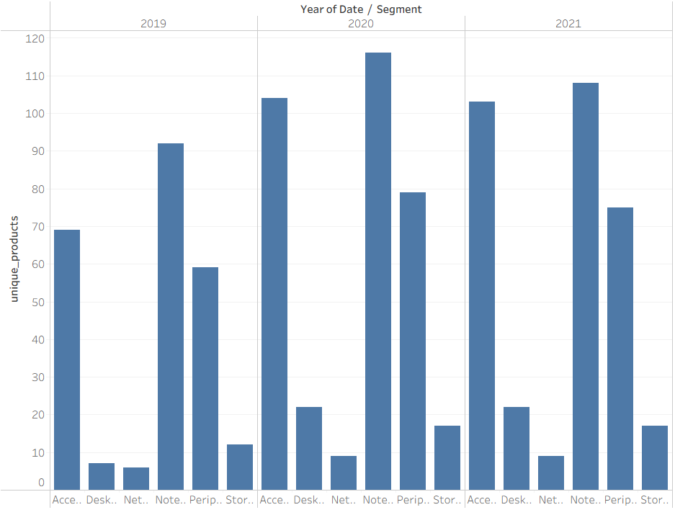
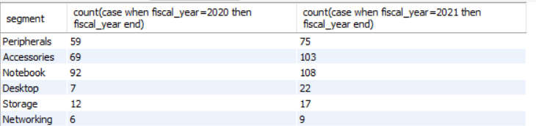
4. Follow-up: Which segment had the most increase in unique products in 2021 vs 2020? The final output contains these fields, segment product_count_2020 product_count_2021 difference
Every major product category—like accessories, desktops, and storage—saw an increase in sales. Notably, desktops had the highest growth rate, suggesting a shift in customer preference or improved product demand.

Slide 9
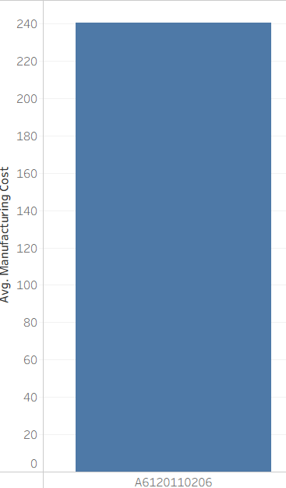
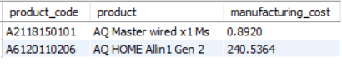
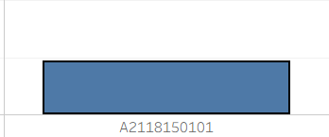
5. Get the products that have the highest and lowest manufacturing costs. The final output should contain these fields, product_code product manufacturing_cost
Certain products and manufacturing units stand out for their efficiency and volume. These should be prioritized for scaling, bundling, or further innovation.

Slide 10
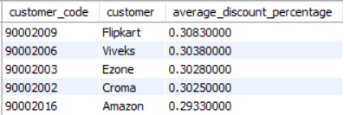
6. Generate a report which contains the top 5 customers who received an average high pre_invoice_discount_pct for the fiscal year 2021 and in the Indian market. The final output contains these fields, customer_code customer average_discount_percentage
Some brands offer deeper discounts, while premium ones like Atliq Exclusive give very minimal discounts. This indicates different positioning strategies across product lines.

Slide 11
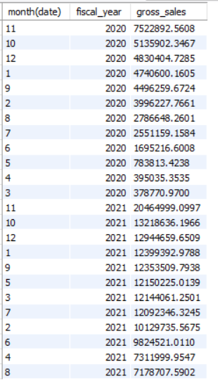
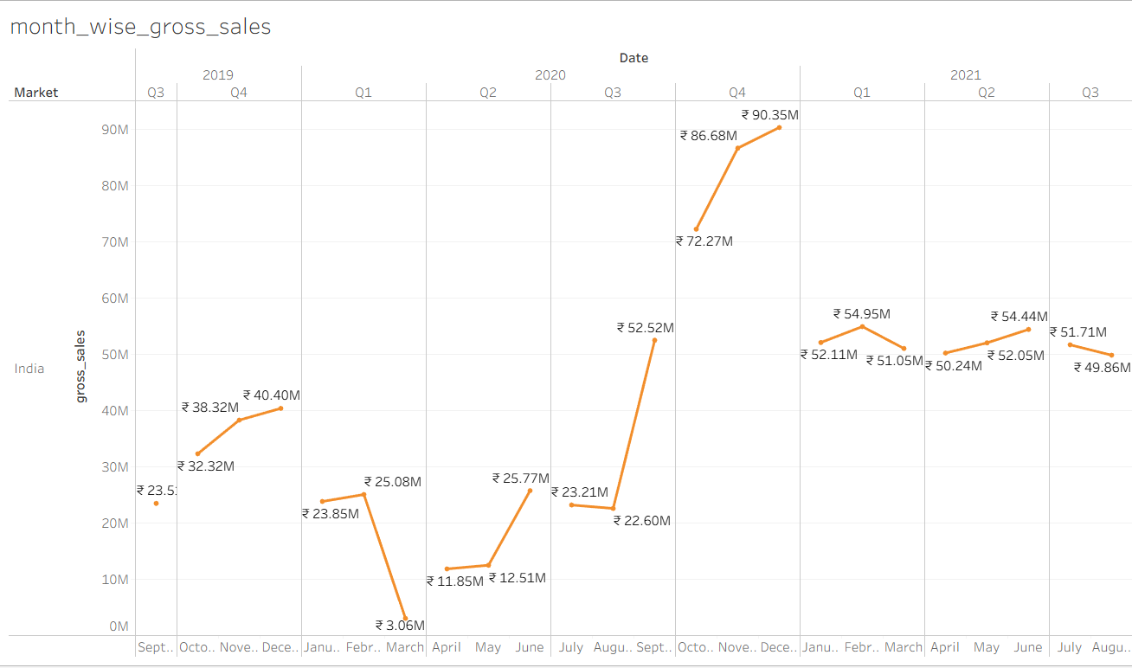
7. Get the complete report of the Gross sales amount for the customer “Atliq Exclusive” for each month . This analysis helps to get an idea of low and high-performing months and take strategic decisions. The final report contains these columns: Month Year Gross sales Amount
Sales consistently rise during certain months—especially around September–October, December, and April–June. This pattern should be used to plan future campaigns and product launches.

Slide 12
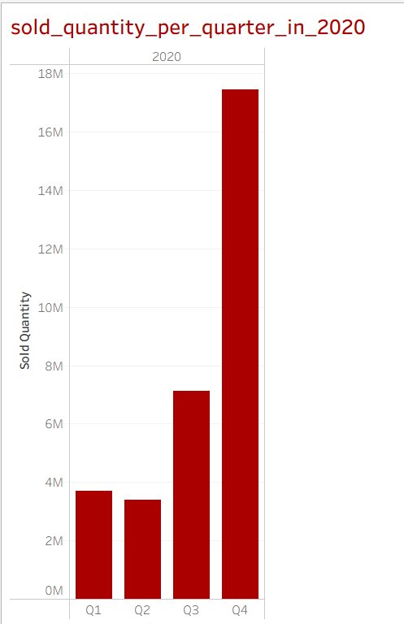
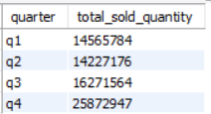
8. In which quarter of 2020, got the maximum total_sold_quantity? The final output contains these fields sorted by the total_sold_quantity, Quarter total_sold_quantity
Quarterly data shows that the first quarter performs best in terms of average sales, while the third quarter tends to be slower. A targeted strategy is needed to lift Q3 performance.

Slide 13
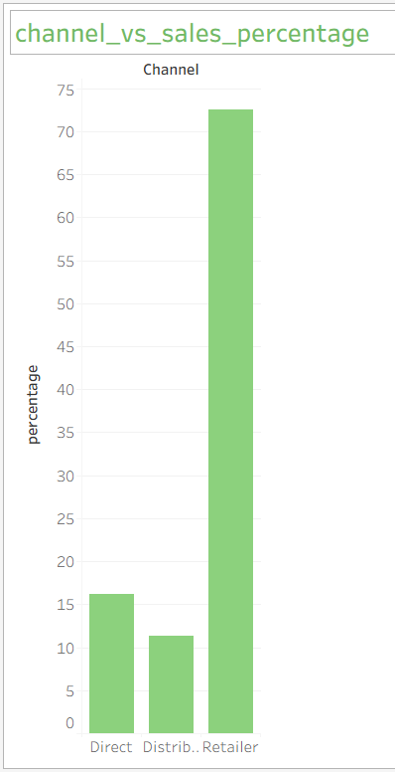
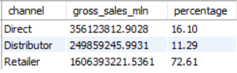
9. Which channel helped to bring more gross sales in the fiscal year 2021 and the percentage of contribution? The final output contains these fields, channel gross_sales_mln percentage
The retailer channel is the company’s biggest contributor to sales by far. However, reliance on a single channel suggests a need to strengthen direct and distributor channels too.

Slide 14
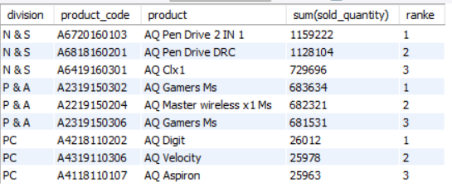
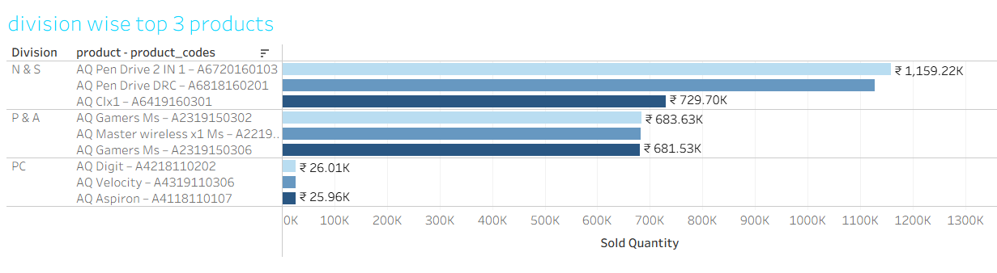
10. Get the Top 3 products in each division that have a high total_sold_quantity in the fiscal_year 2021? The final output contains these fields, division product_code product total_sold_quantity rank_order
In both tech and accessories, a few key products consistently perform best. These should be highlighted in marketing and stock planning.

Slide 15
Overall Summary of Insights

Slide 16
India is the strongest and most consistent market in APAC.
Business performance improved significantly from 2020 to 2021.
All product segments saw growth — especially desktops and accessories.
Premium brands offer lower discounts; mass-market brands offer higher.
Sales peak during festive and summer months (Sept–Oct, Apr–Jun).
Q1 is the best-performing quarter; Q3 shows the lowest sales.
AQ Pendrive and AQ Gamer are top-performing products.
Gaming and digital accessories are rising in popularity.

Slide 17
RECOMMENDATIONS TO THE
MANAGEMENT

Slide 18
1. Focus on High-Growth Segments
Increase investment in Desktops and Accessories, which show over 30%+ growth.
Enhance production and distribution of high-demand products like DCF-2 Home Layer

Slide 19

2. Strengthen Retail Strategy
Maintain and enhance support for retail partners, your primary sales channel.
Use loyalty programs or exclusive deals to retain and grow retailer engagement.

Slide 20

3. Optimize Discounting
Reassess high-discount brands (e.g., Electric E-Store) to balance volume with profitability.
Use tiered discount strategies based on market performance.

Slide 21

4. Time Marketing with Sales Seasons
Launch key campaigns in April–June and September–December.
Introduce product launches or bundling
offers aligned with sales peaks.

Slide 22

5. Expand Data Analytics Team
Hire data analysts to automate reporting, forecast
trends, and support faster decisions.
Equip team with tools like Tableau and SQL
for scalable insights delivery.

Slide 23


Technical Skills
SQL: Joins, Aggregations, Window Functions, Subqueries
Tableau: Dashboards, Charts
Data Analysis: Trend comparison, segmentation,
product/customer insights

Slide 24

THANK YOU
I appreciate your time reviewing this case study.
I'm excited about the opportunity to contribute to data-driven decision-making at Atliq Hardware.
📫 Contact Info:
📧Mail@gmail.com
🔗 LinkedIn
💻 GitHub

